Slide 1


Creating the responsive supply chain

Slide 2


Main Title Goes Here….
Product ‘push’ versus demand ‘pull’
The Japanese philosophy
The foundations of agility
A route-map to responsiveness
www.umt.edu.pk

Slide 3
The foundations of agility
Ability to respond rapidly to demand & supply changes
  Network-wide concept
  Requires collaboration & shared information
Discussion:
Is agility possible without collaboration across firms? (Pen Down your Answers)

Slide 4
Why Agility Matters Today
Volatile demand
Shorter product life cycles
Customer-driven markets
Competitive pressure
Discussion:
Which Pakistani industry faces the highest demand volatility? Why?

Slide 5
1 Synchronise activities through shared information
One set of numbers
Shared demand, inventory & capacity data
Reduces bullwhip effect
Discussion:
What prevents Pakistani firms from sharing real-time data? (Very Important Point)

Slide 6
2 Work Smarter, Not Harder
Remove non-value-adding activities
Process re-engineering
Parallel processing
Discussion:
Give examples of non-value-adding activities in local supply chains. (As per your visit)

Slide 7
3 Partner with Suppliers
Close collaboration
Joint problem-solving teams
ERP/SAP integration
Discussion:
Why do firms hesitate to collaborate closely with suppliers?

Slide 8
4 Reduce Complexity
Excessive SKUs (Stock Keeping Units)
Fragmented demand
Frequent product changes
Discussion:
Does product variety always increase sales?

Slide 9
5 Postponement Strategy
Delay final product configuration, packaging, or distribution
Products remain generic as long as possible
Types:
Form postponement (late assembly/configuration)
Place postponement (centralised inventory)
Benefits:
Lower inventory risk
Higher flexibility and availability

Slide 10
6 Manage Processes, Not Functions
Functional silos slow decision-making
Agile firms focus on end-to-end processes:
  Customer-facing
  Cross-functional
Use interdisciplinary process teams
Faster response due to fewer hand-offs and flatter decision structures

Slide 11
7 Performance Metrics for Agility
Time-based metrics
Perfect order fulfilment
Time-to-market
Discussion:
Which KPIs discourage agility in Pakistani firms?

Slide 12
Pakistani Case – FMCG
Companies: Nestlé, Unilever, Engro
POS-based replenishment
SKU rationalisation
Discussion:
How can local retailers support FMCG agility?

Slide 13
Mini Assessment Case (Pakistan)
A Karachi-based FMCG firm supplies 500 retail outlets.
Average demand = 10,000 units/week.
Current lead time = 3 weeks.
Tasks:
1. Calculate pipeline inventory.
2. Suggest two agility strategies.
3. Identify one performance metric to improve responsiveness.

Slide 14
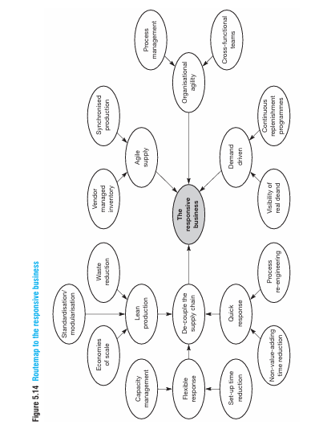
A routemap to responsiveness
Modern businesses must be market-driven, not internally driven. Competitive advantage comes from responsiveness across the entire supply chain, not cost efficiency alone.

Slide 15
Key Elements of a Responsive Business:
Organisational Agility:
Cross-functional, process-oriented teams replacing functional silos.
Agile Supply:
Close supplier collaboration, synchronized production, and shared information.
Demand-Driven Focus:
Real customer demand visibility and continuous information flow.
Lean Foundation:
Waste reduction, standardization, economies of scale, and capacity management.
Decoupling & Postponement:
Lean upstream (forecast-driven) + Agile downstream (order-driven) operations.
Outcome:
Firms that integrate these elements respond faster to customer needs and consistently outperform competitors.

